Slide 1
App Insights
Presenter: Samir Bellouti
Software Architect / Sabbel Conseils Inc.

Slide 2
Agenda

Slide 3
Section 6 App Insights

Slide 4

What is App Insights ?
It is an Application Performance Monitoring (APM)
Gives you the ability monitor your application after it is deployed with a sufficient level of details for a developer
Adds telemetry to your development lifecycle
Helps your team detect issues before customers start to complaint
Other APMs: App Dynamics, Raygun, new relic….

Slide 5
How does it work ?
Can be used on Azure or on premise
Intercepts inbound and outbound requests and logs data asynchronously
Data is kept for 90 days
You’re billed according to the amount of data received by App Insights
The impact on the performance is very limited

Slide 6
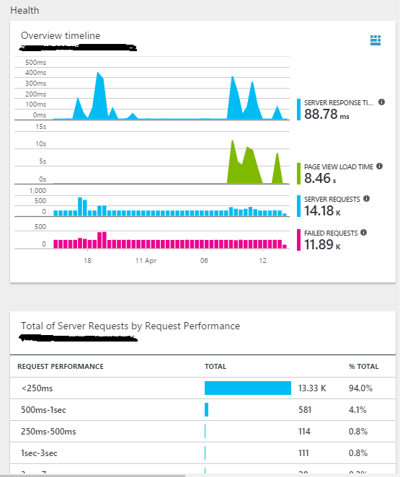
What can it track?
Server response time
Page view load time
Server requests
Failed requests
Exceptions
Real time monitoring
Dependencies performance and failure
Custom events
Users’ behavior
You can set alerts based on recorded metrics
Tracing, profiling (new)….

Slide 7
Examples

Slide 8
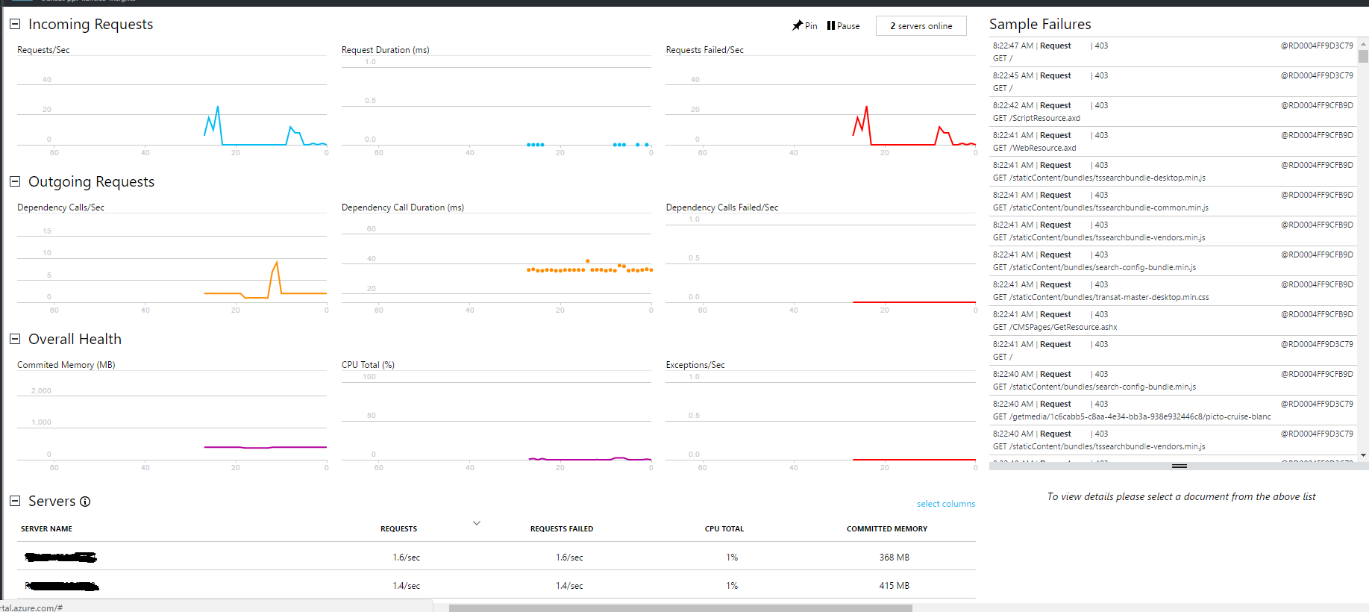
Real Time Monitoring

Slide 9
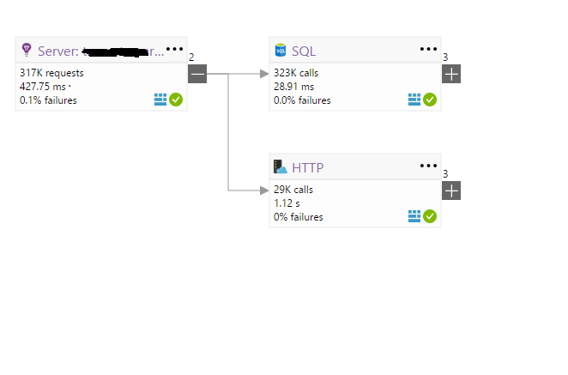
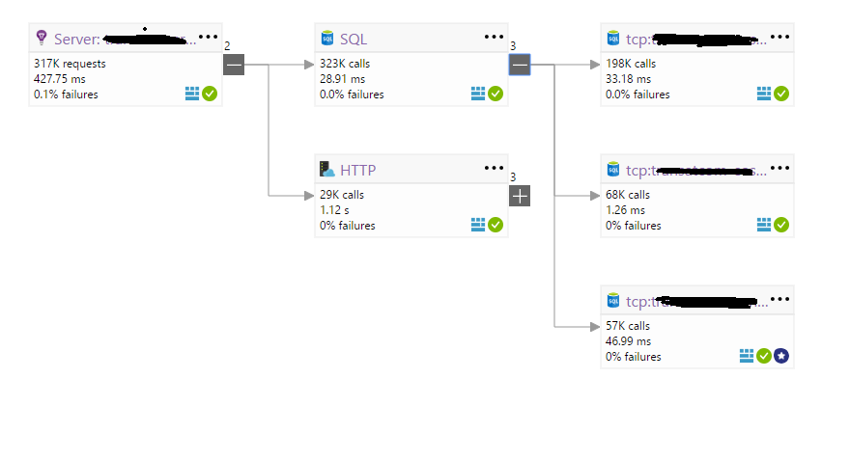
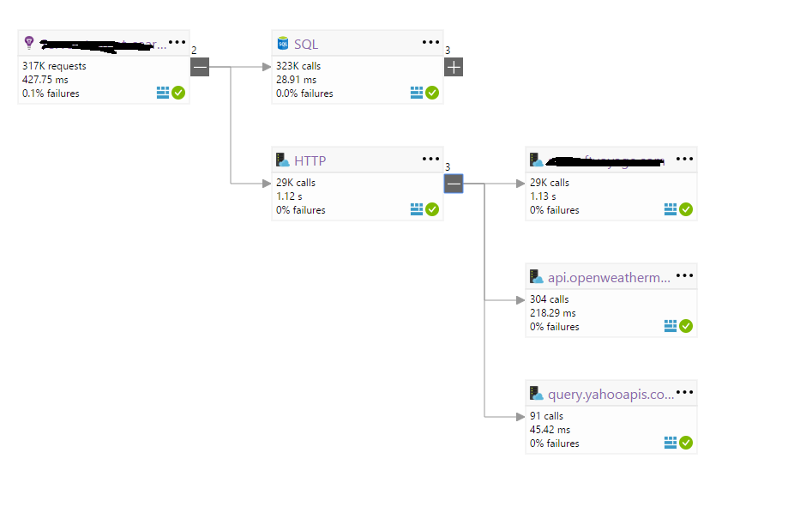
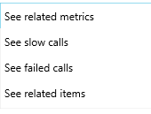
Application Map

Slide 10
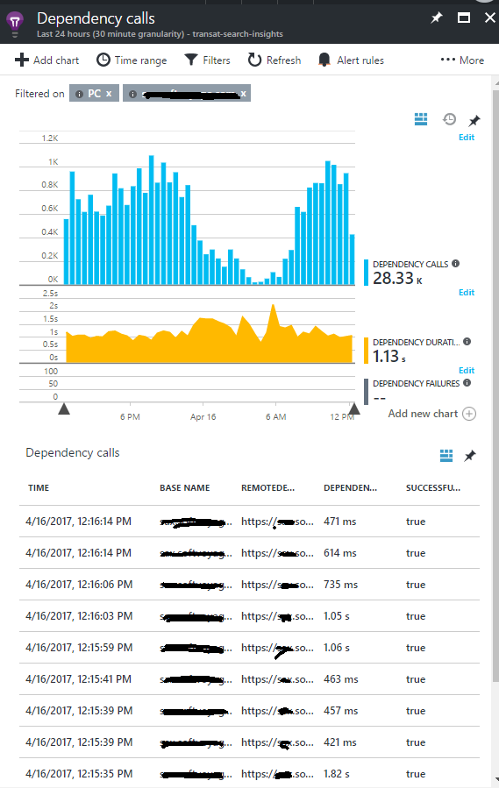
Dependencies
Number of times a dependency is called
Dependencies performance
Dependencies failures

Slide 11

Custom Queries
You can access logged data and create your own queries and graphs
You can share your queries
You can add the graphs to your Azure dashboard…

Slide 12
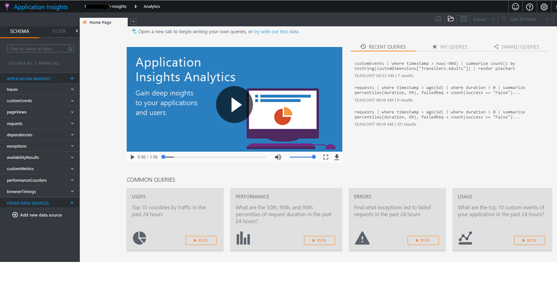
Analytics

Slide 13
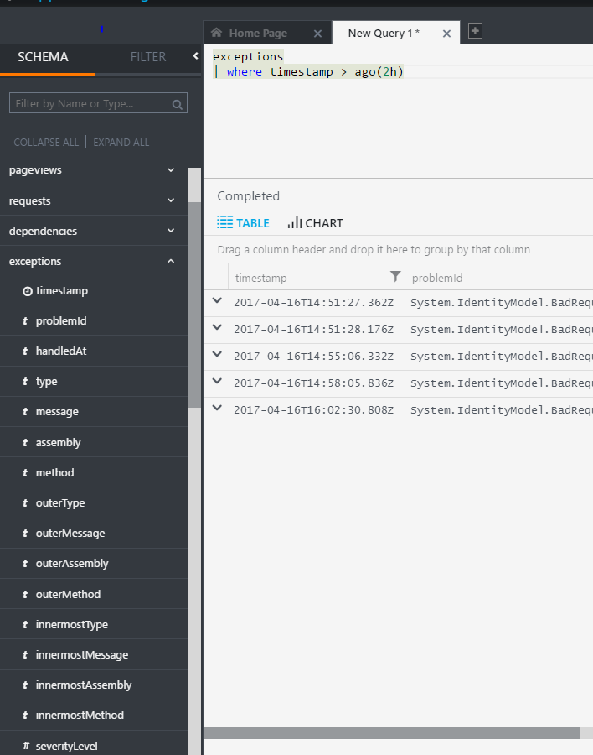
Analytics
Available entities with related properties are displayed on the left
Works with pipes: every pipe means a new table created behind the scenes
Always narrow the timeframe for which you do your query (huge performance impact on the query)
Do not forget to take into account the sampling model you have chosen

Slide 14
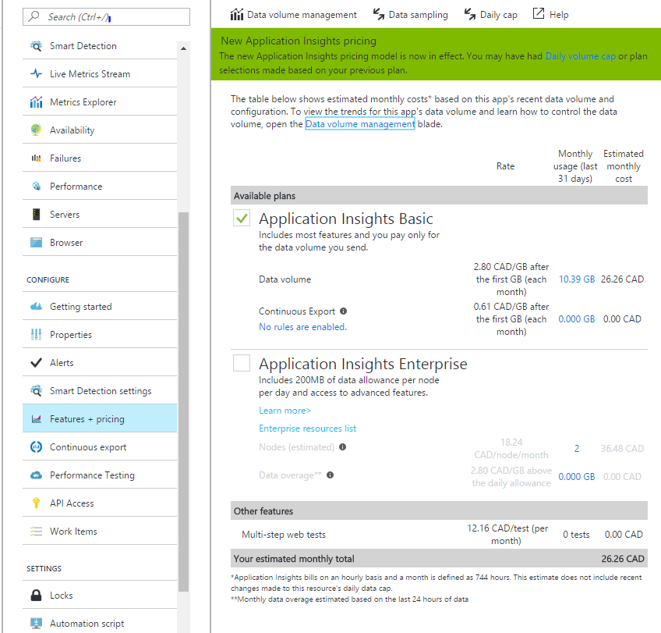
Data sampling & Configuration
By default, App Insights records all the data sent (1:1)
You can configure data sampling policies (Application side)
You can filter the data sent to App Insights
Data sampling has an impact on the cost and the way you write custom queries
You can set a daily data cap to control costs

Slide 15
Demo:

Slide 16
References:
https://azure.microsoft.com/en-us/services/application-insights/
https://docs.microsoft.com/en-us/azure/application-insights/app-insights-analytics

Slide 17
Q&A

